Slide 1

COLOR
DETECTION
TEAM:
ABHISHEK SINGH (RA2011026010098)
KESHAV HANDA (RA2011026010088)
SECTION : Q1

Slide 2
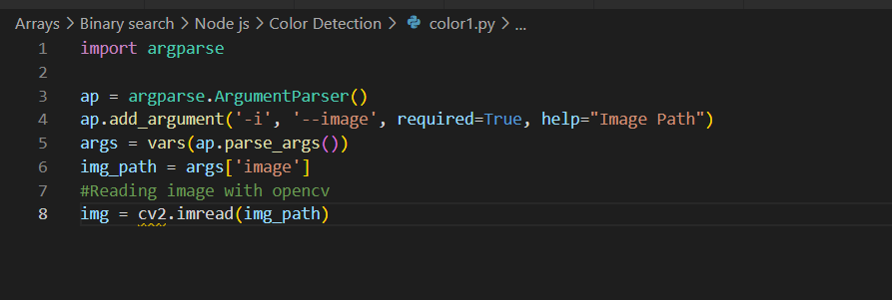
IMPLEMENTATION
Step 1 : Importing required package and load the image
We are using argparse library to create an argument parser. We can directly give an image path from the command prompt :

Slide 3
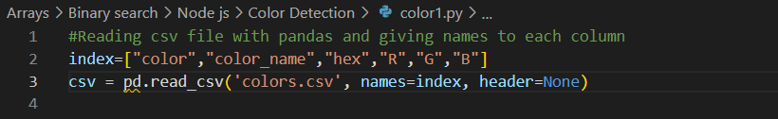
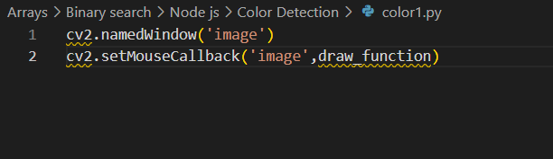
STEP 2 : we read the CSV file with pandas
The pandas library is very useful when we need to perform various operations on data files like CSV. pd.read_csv() reads the CSV file and loads it into the pandas DataFrame. We have assigned each column with a name for easy accessing.
STEP 3 : Set a mouse callback event on a window

Slide 4

STEP 4 : Create the draw_function
It will calculate the rgb values of the pixel which we double click. The function parameters have the event name, (x,y) coordinates of the mouse position, etc. In the function, we check if the event is double-clicked then we calculate and set the r,g,b values along with x,y positions of the mouse.

Slide 5

Step 5 : Calculate distance to get color name
We have the r,g and b values. Now, we need another function which will return us the color name from RGB values. To get the color name, we calculate a distance(d) which tells us how close we are to color and choose the one having minimum distance.
Our distance is calculated by this formula:
d = abs(Red — ithRedColor) + (Green — ithGreenColor) + (Blue — ithBlueColor)

Slide 6
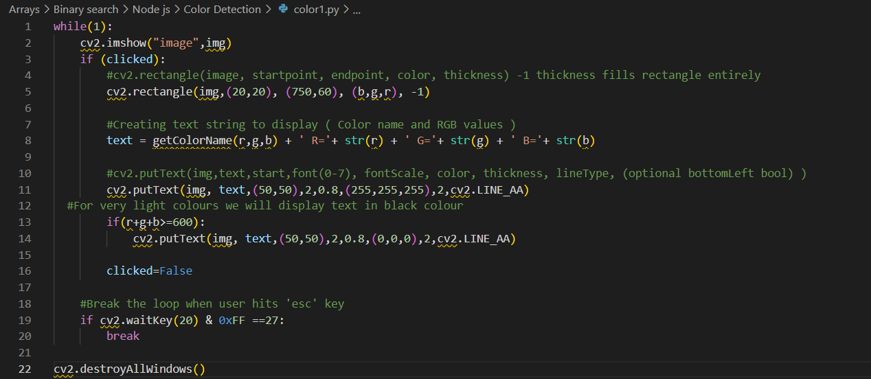
Step 6 : Display image on the window And Run The Code
Whenever a double click event occurs, it will update the color name and RGB values on the window.
Using the cv2.imshow() function, we draw the image on the window. When the user double clicks the window, we draw a rectangle and get the color name to draw text on the window using cv2.rectangle and cv2.putText() functions.

Slide 7
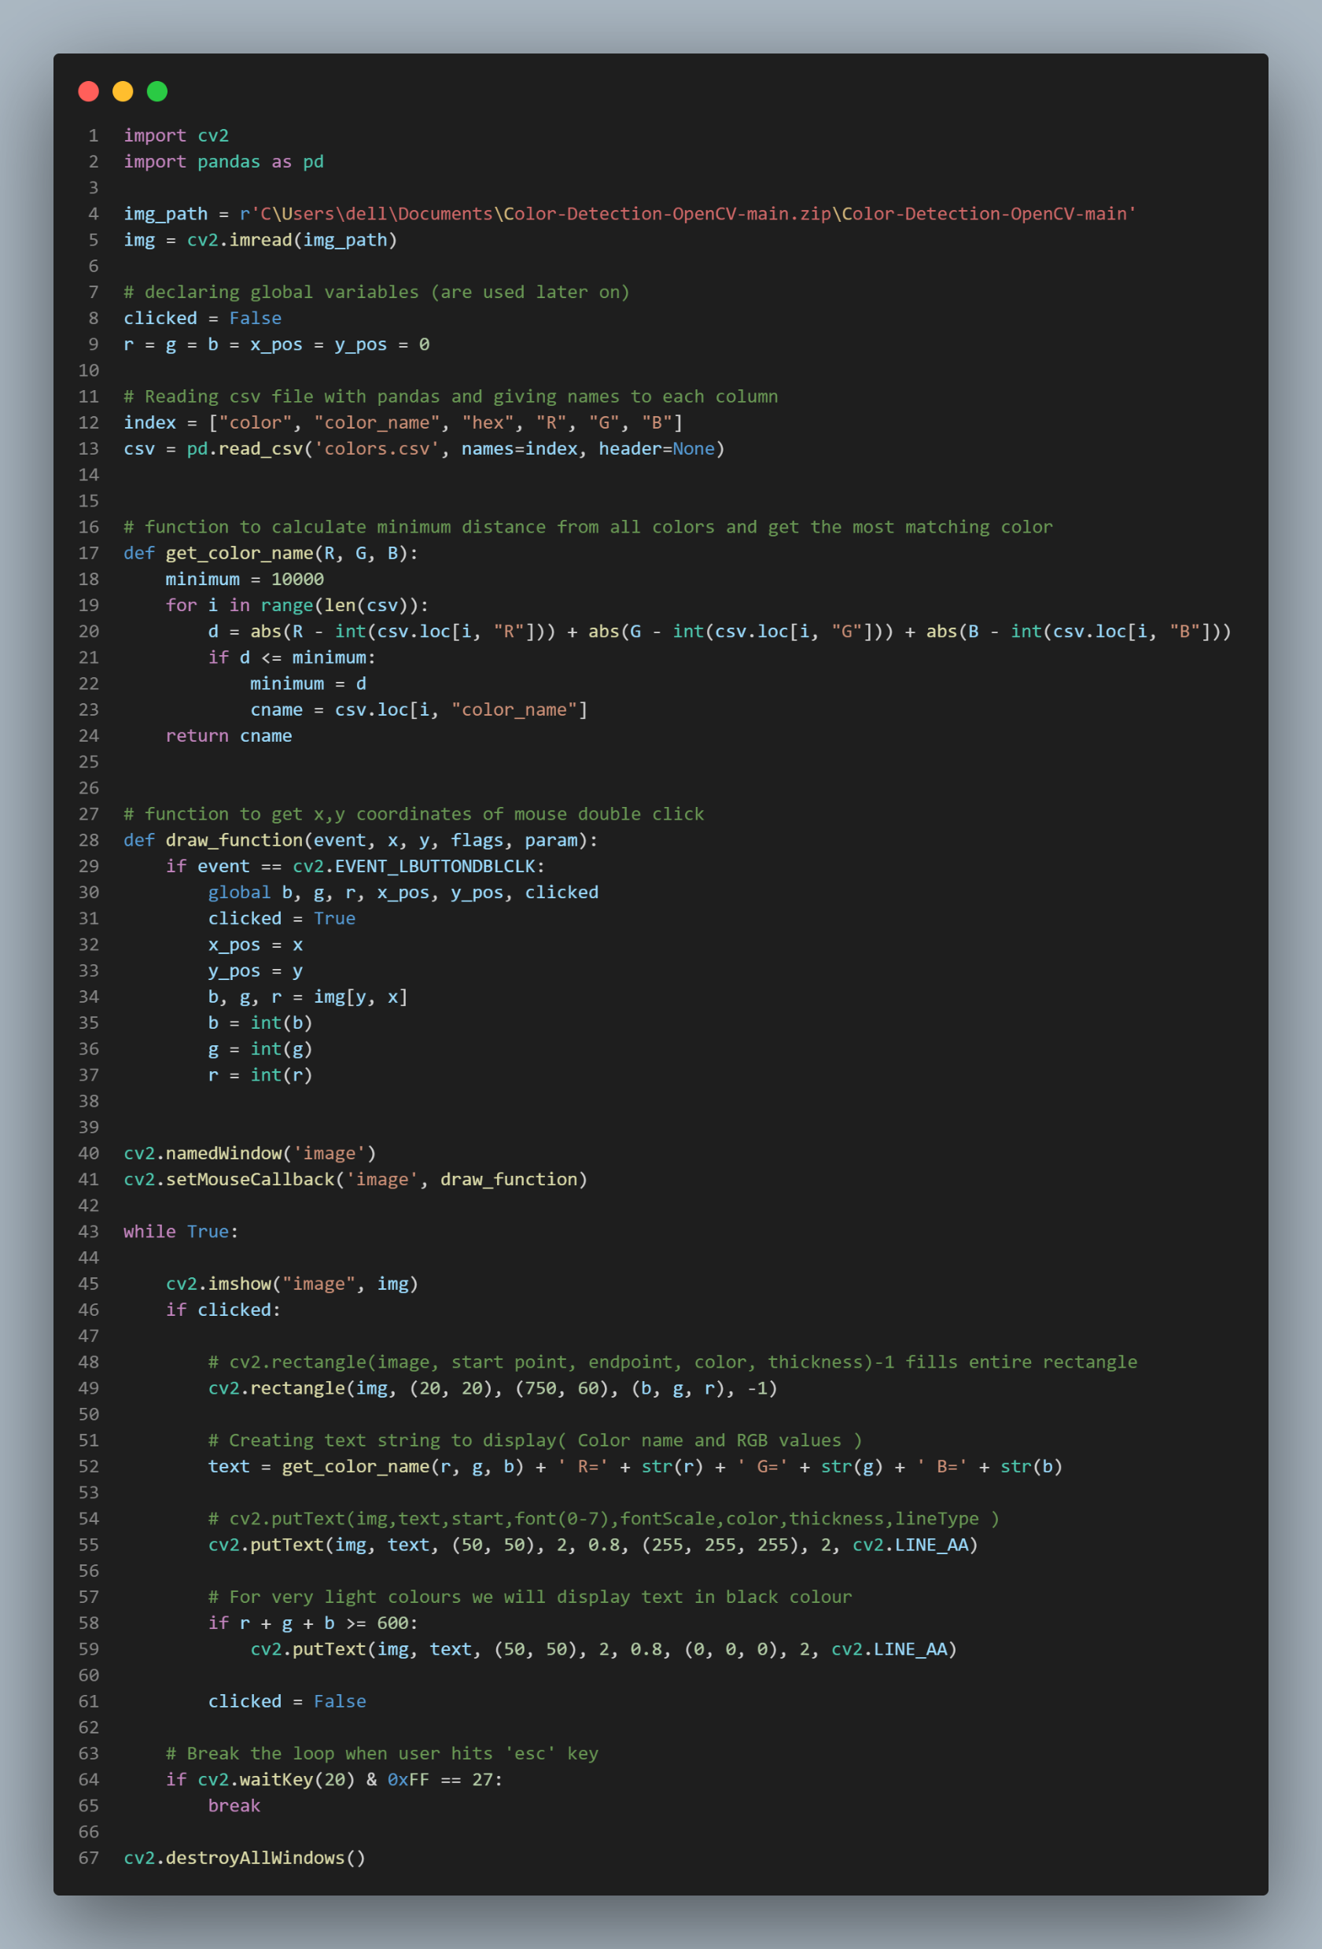
Whole code :

Slide 8
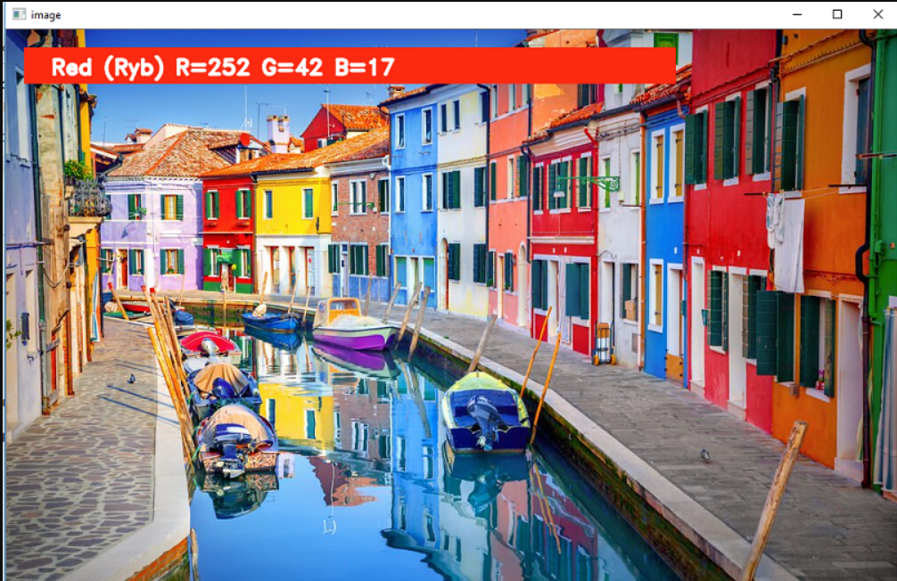
RESULT 1 :

Slide 9
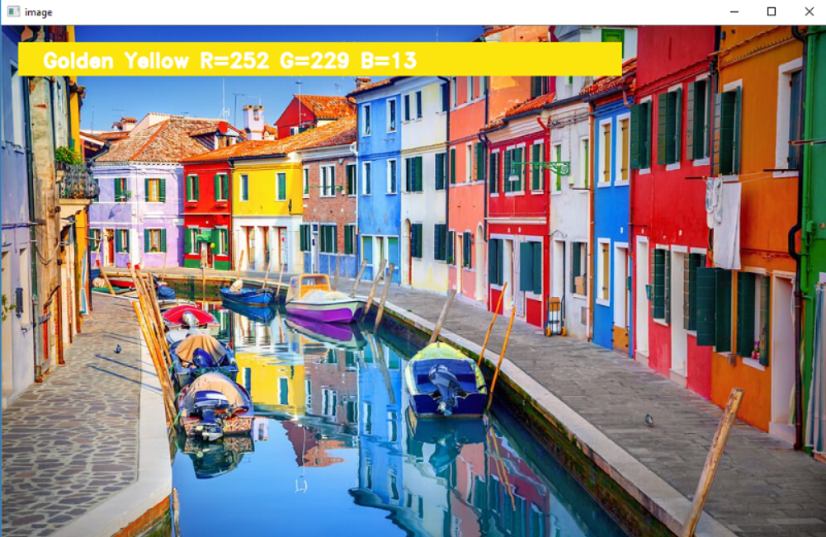
RESULT 2 :

Slide 10
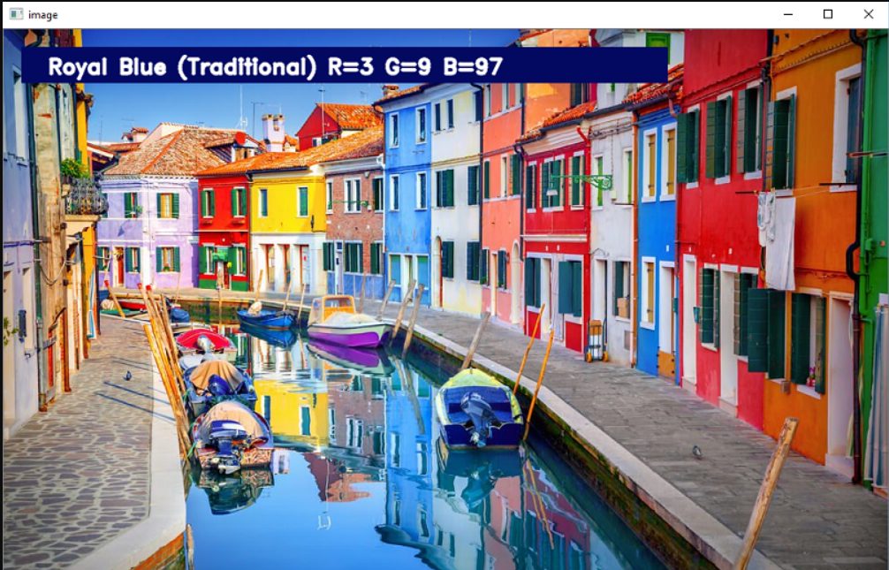
RESULT 3 :

Slide 11
CONCLUSION
Computer Vision – Color detection is the basic and important step for proceeding in computer vision .
Object Segregation – An object can be segregated (separated) on the basis of its color .
Object Tracking – A moving object can be tracked on the basis of its color

Slide 12
THANK YOU

